Slide 1
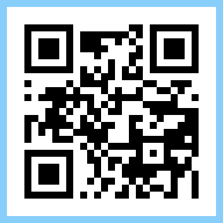
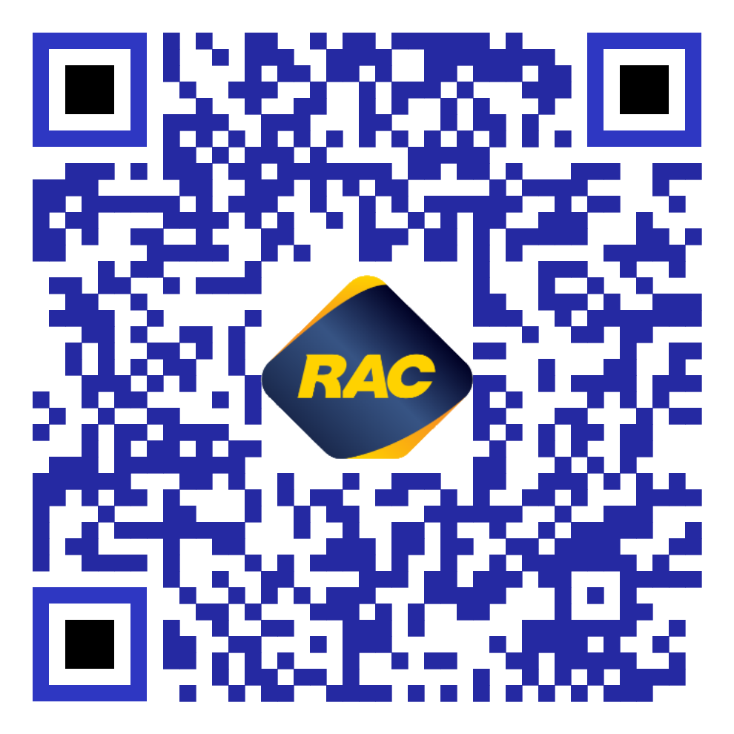
Team Quick Response!
QR Codes
Team Members
Aaron Herbert David De Carlo

Slide 2


QR Codes to support the claim process
Utilise QR Code stickers to easily access a particular online RAC Claim form.
Currently it can be daunting for a policy holder to make a claim
What was my policy number? Where is the claim form? Ah bugger I’ll just call RAC!

Slide 3
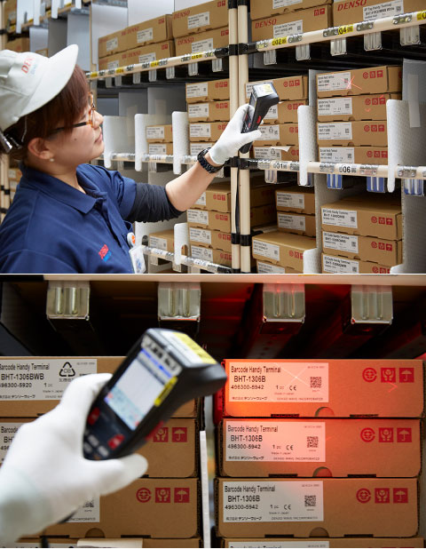
What are QR Codes?
They were created in 1994 by Denso Wave to track vehicles during manufacturing. They quickly gain popularity when it spread to smartphones.
You can now even scan QR Codes from your phone camera.

Slide 4
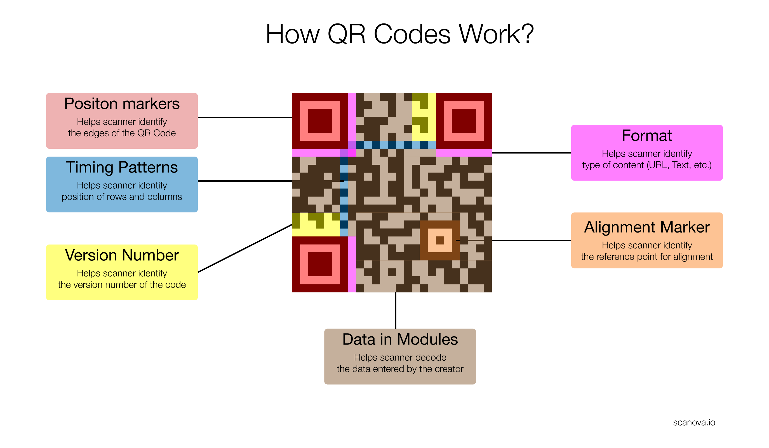
What are QR Codes?

Slide 5

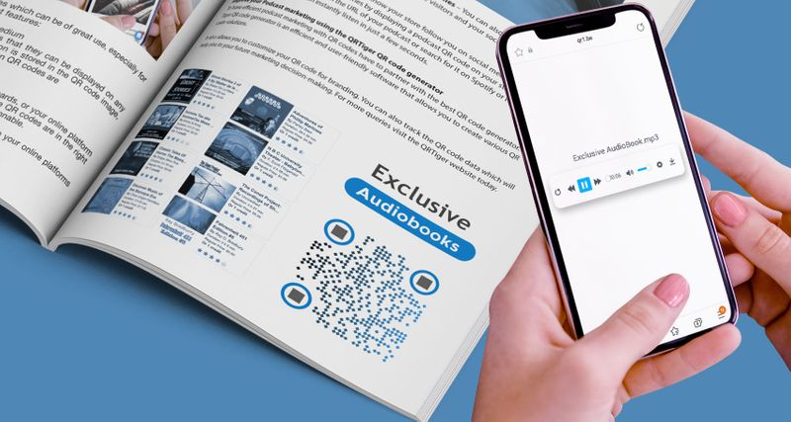
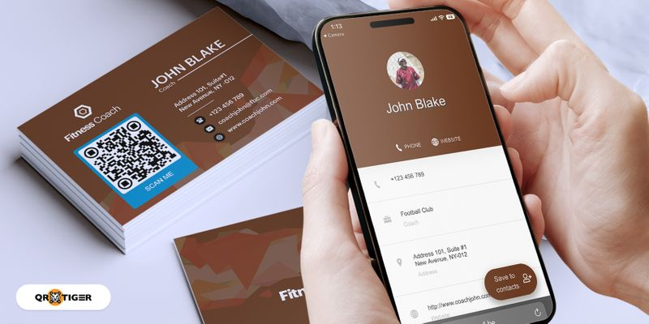
What are their existing uses?
Connect easier to wifi
E-learning
vCards
Restaurants – Digitized menus

Slide 6



What have you achieved
Solution Name: RAC Quick Response Claim
Create a solution using QR Codes
- 1. QR Code created using qr.io - 2. Static website created for quick claim redirect landing page. - 3. Utilise GitHub actions (Build and deploy pipeline) - 4. Generate our own service to create QR codes leveraging existing .NET 6 libraries

Slide 7
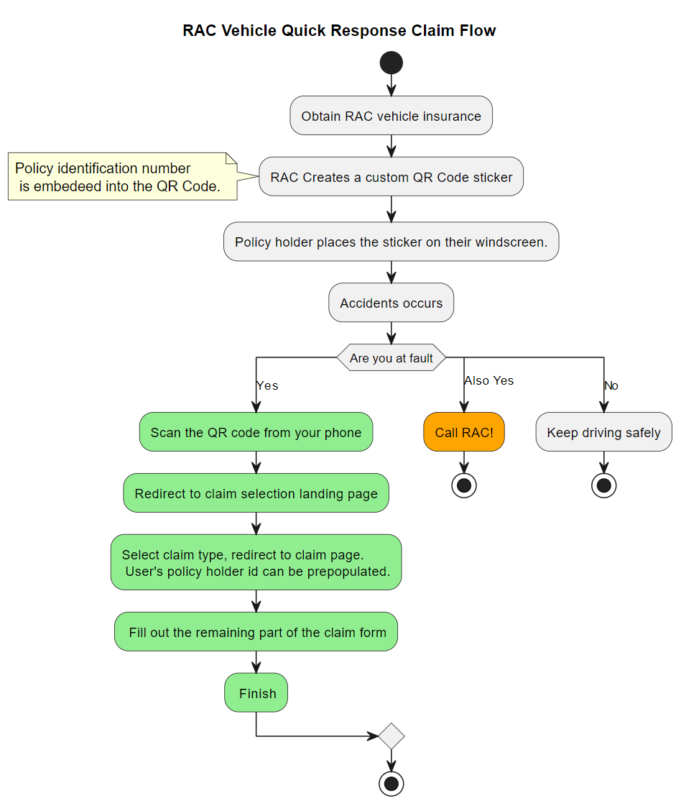
Making a claim flow

Slide 8

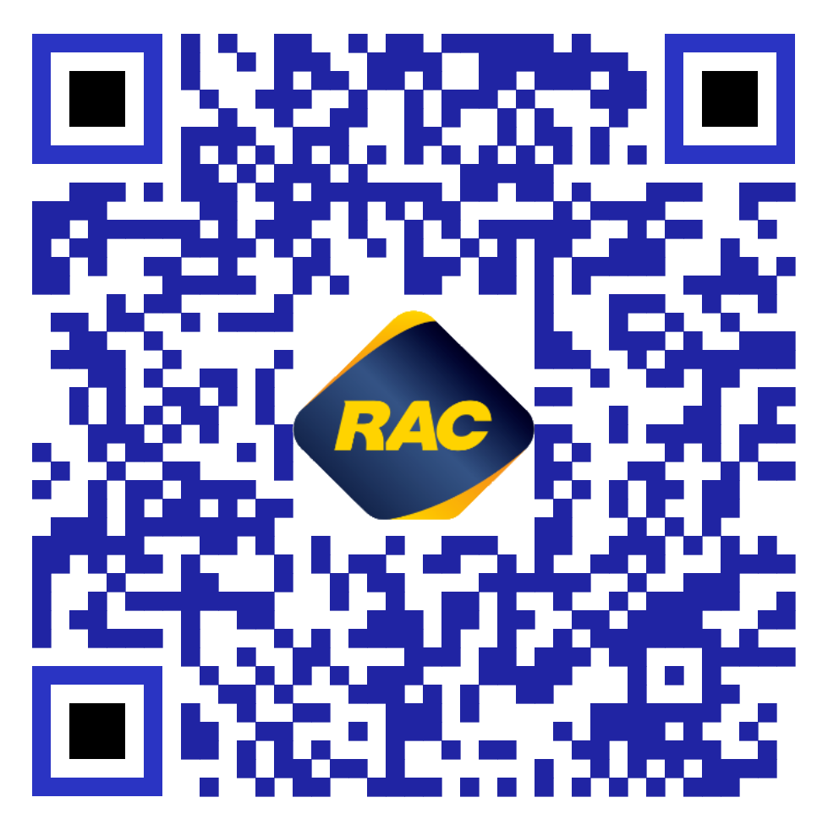
1. Place your QR sticker

Slide 9
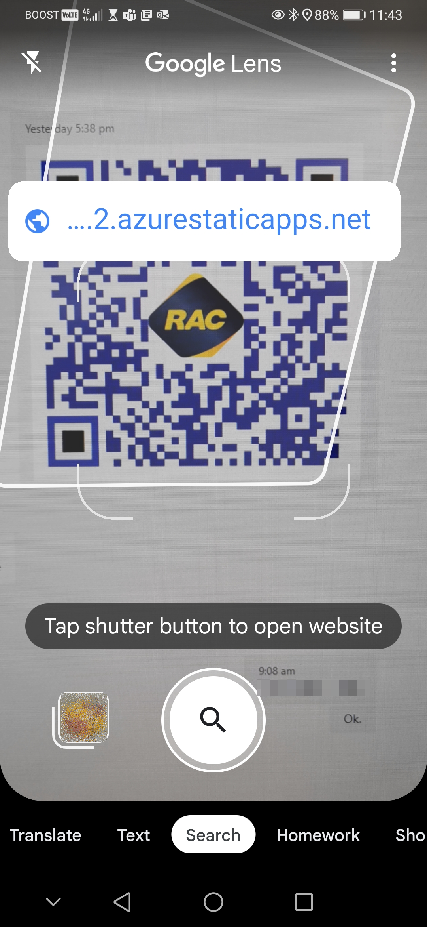

2. Scan the RAC QR sticker
When making a claim your QR sticker will redirect you to RAC landing page to make the appropriate claim.
Based on willingness of the business the policy identification can be incorporated into the QR code.
Google Lens

Slide 10
2. Scan the RAC QR sticker …
Scan Me!

Slide 11
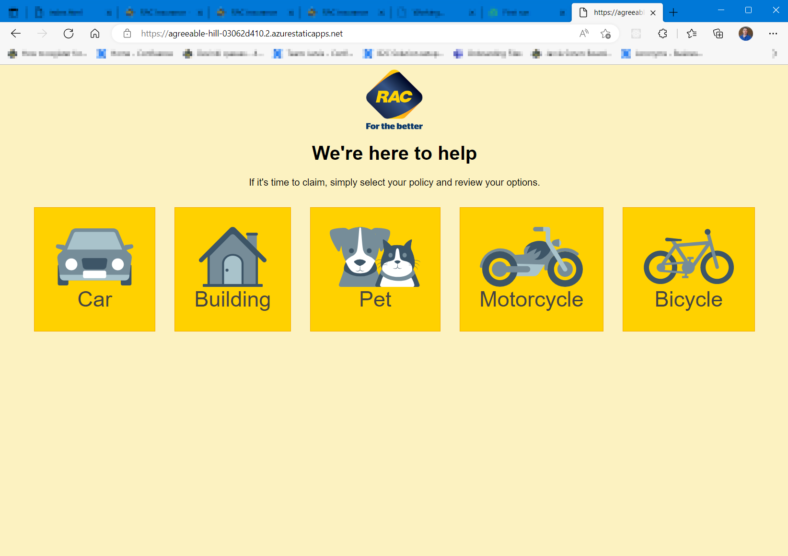
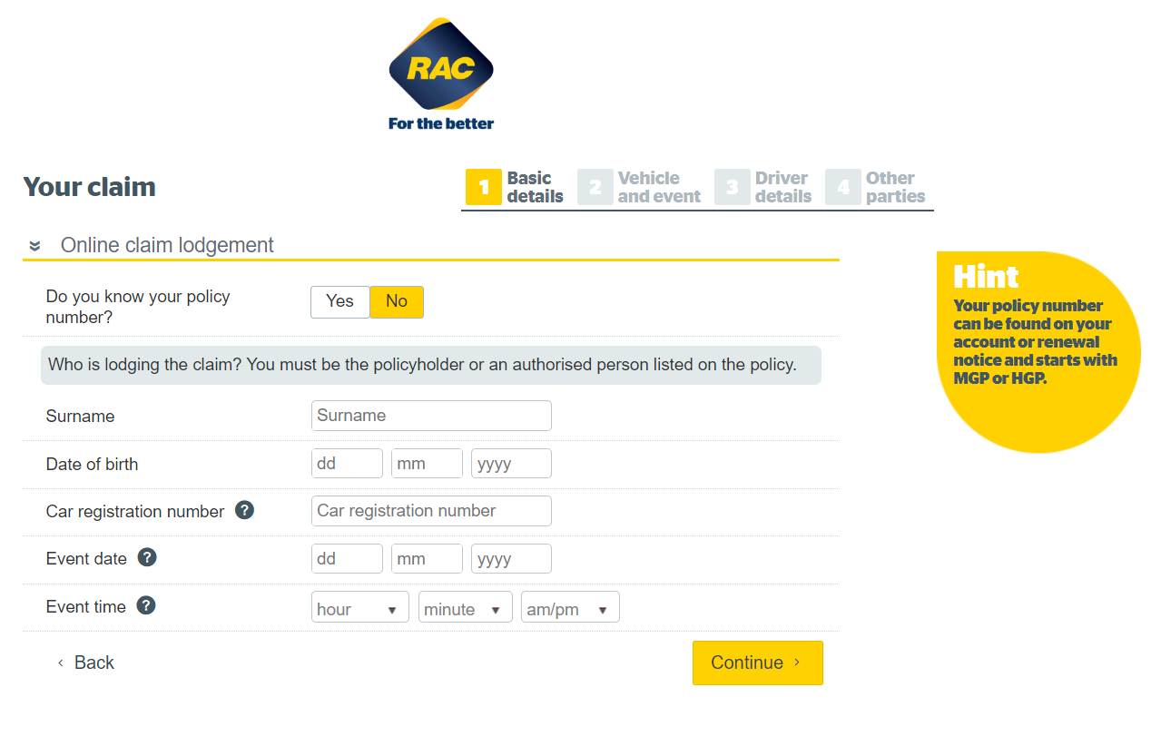
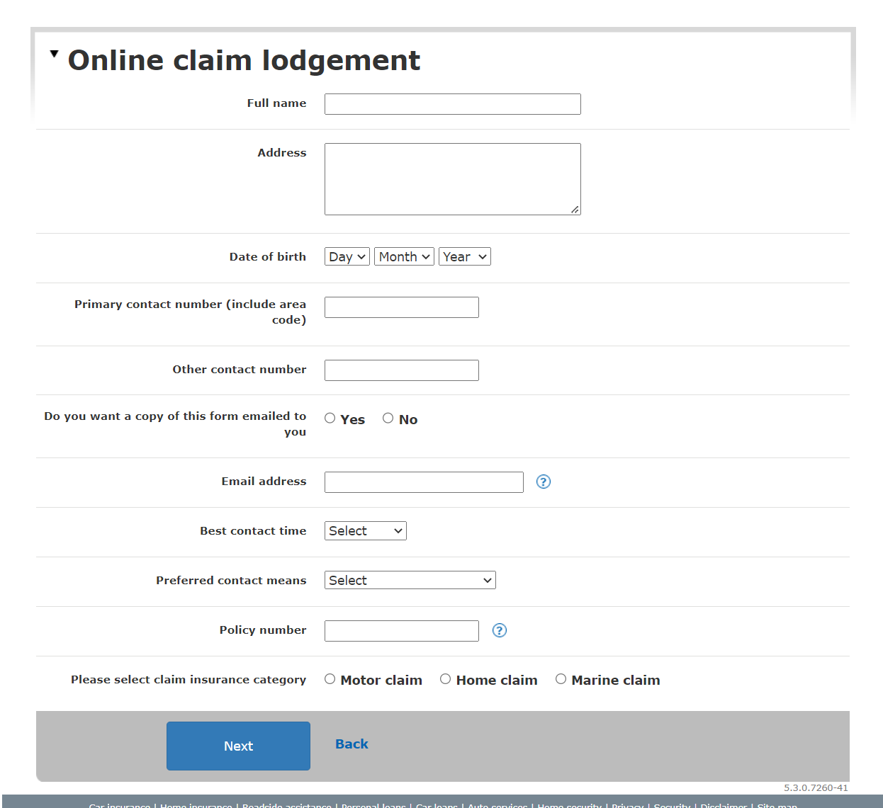
3. Redirect to landing site
Make a selection of the type of claim you are making.
https://agreeable-hill-03062d410.2.azurestaticapps.net/

Slide 12
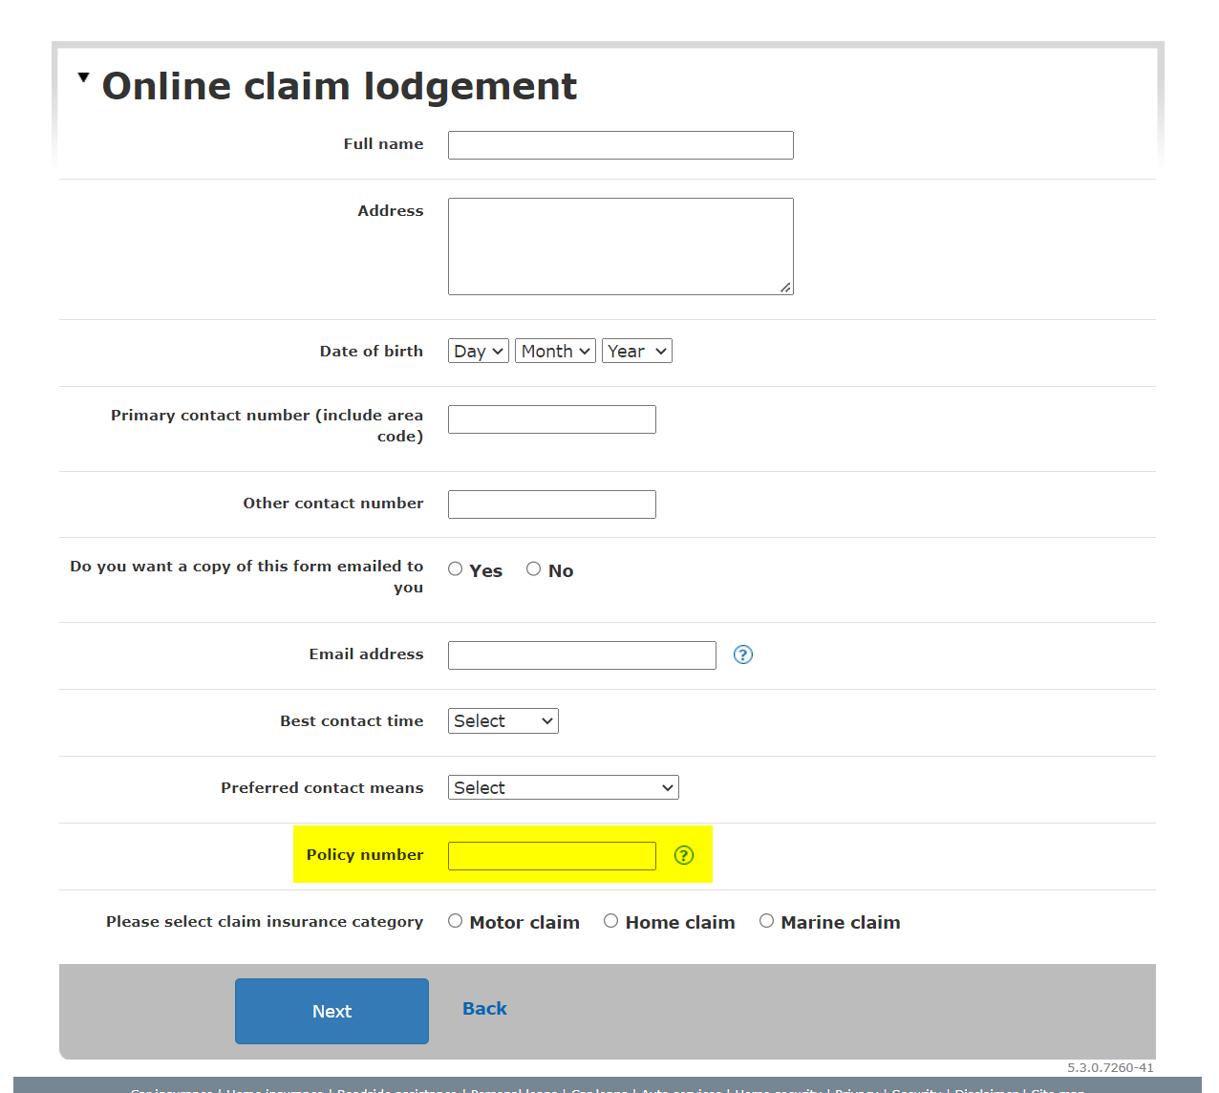
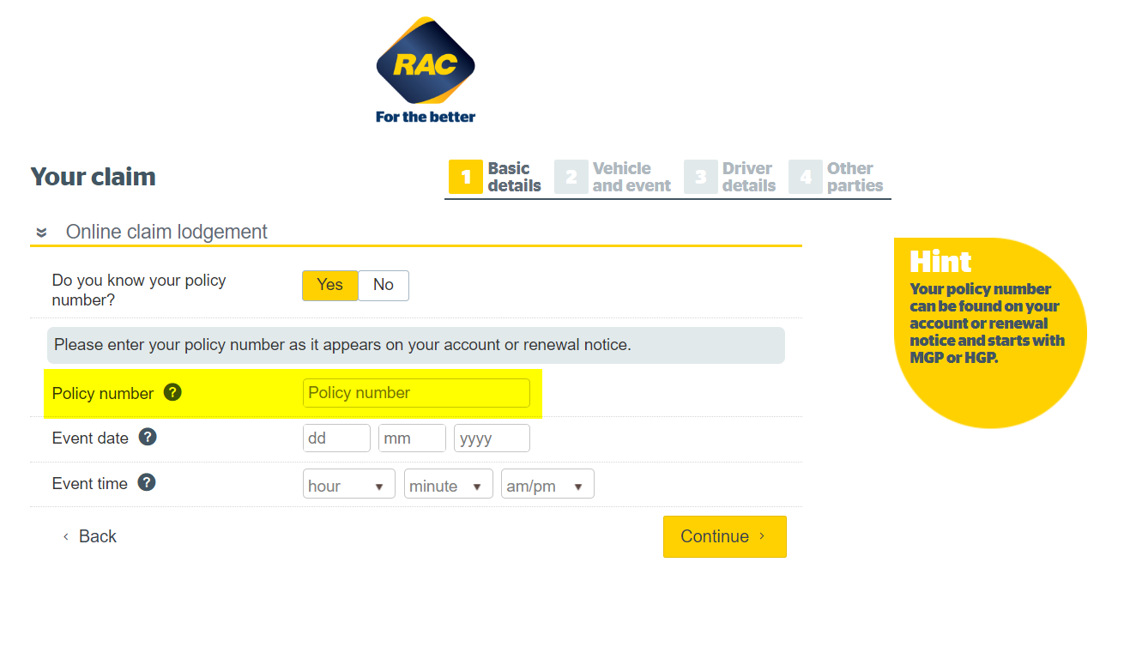
4. Complete the claim form
The QR code may contain your policy number. This could possibly be prepopulated into the form

Slide 13

5. Finished
Happy to quickly move through the claim process quickly.

Slide 14
What can RAC get out of this
Everyone owns a mobile smart phone. Members will be further impressed with the uptake of innovation to assist the member experience.
Key Success Metrics i.e.
Business value
Time savings
Cost savings
Member benefits
Training benefit

Slide 15
What have you learnt
The many existing libraries and services available to assist creating QR codes.
Learnt to utilise GitHub actions to perform deployments to azure
Integration of an existing library into a .NET API application to generate QR Codes
RAC has room to take advantage of QR Codes. Lets see it move on from desk booking and into the hands of our members!

Slide 16
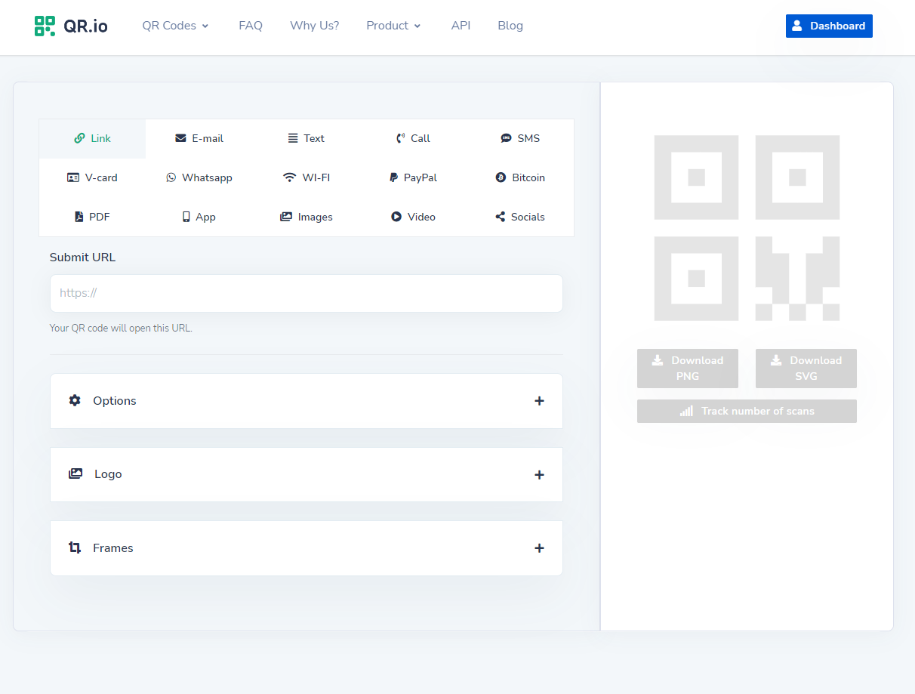
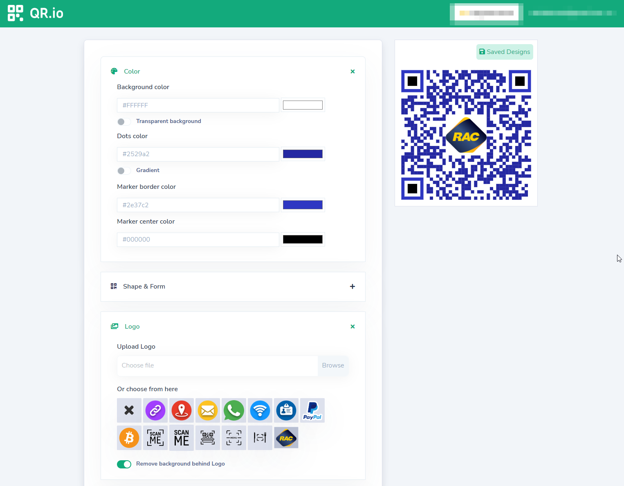
What have you learnt

Slide 17
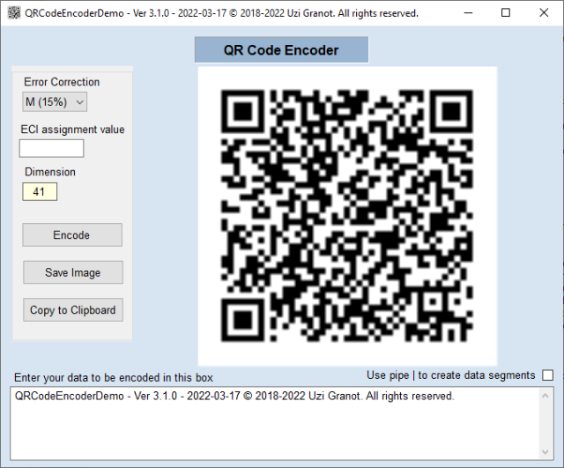
References
qr.io online service to quickly create highly customisable qr codes https://qr.io/
Encoder and Decoder library for .NET 6 https://www.codeproject.com/Articles/1250071/QR-Code-Encoder-and-Decoder-Csharp-Class-Library-f
https://en.wikipedia.org/wiki/QR_code

